Slide 1

Personal Library
By
Awais Akbar
Karthick Pandi
Yang Wang

Slide 2
FRONT END

Slide 3
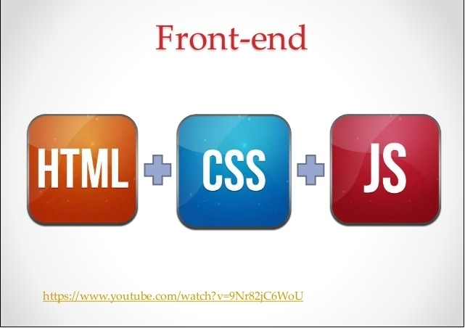

Slide 4
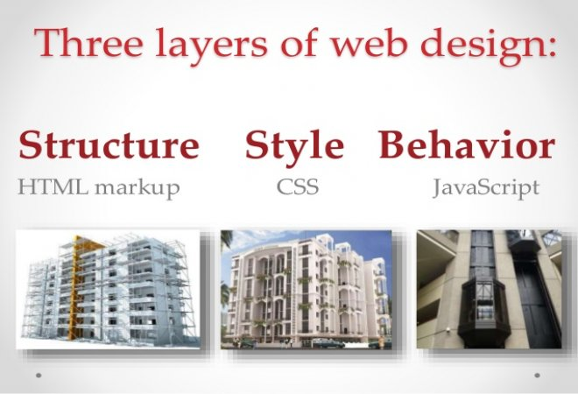

Slide 5
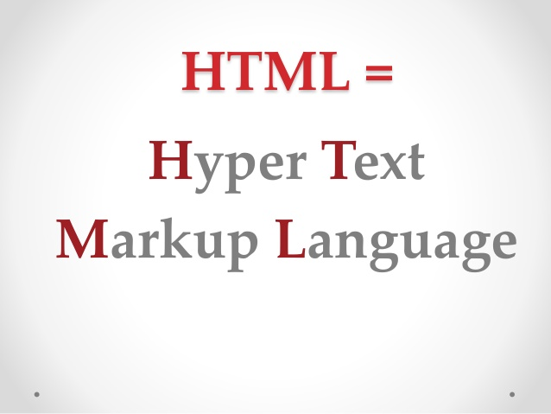

Slide 6
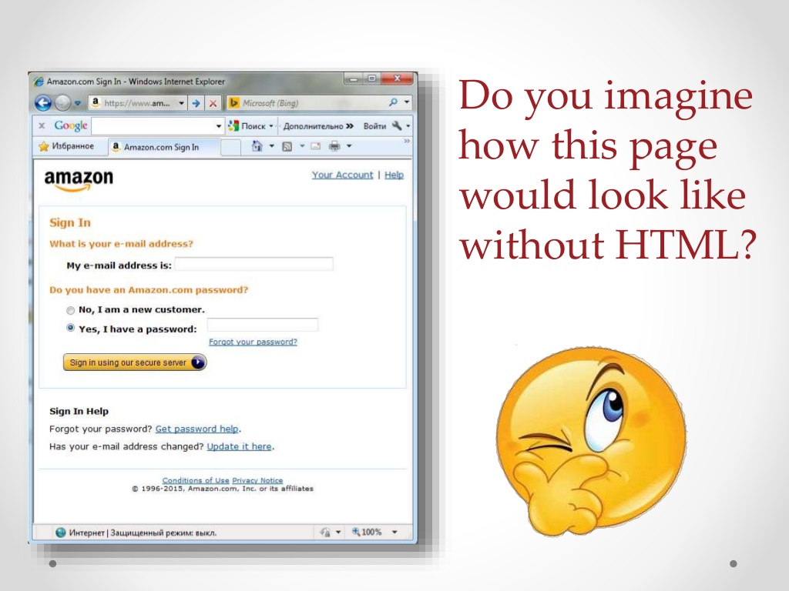

Slide 7


Slide 8
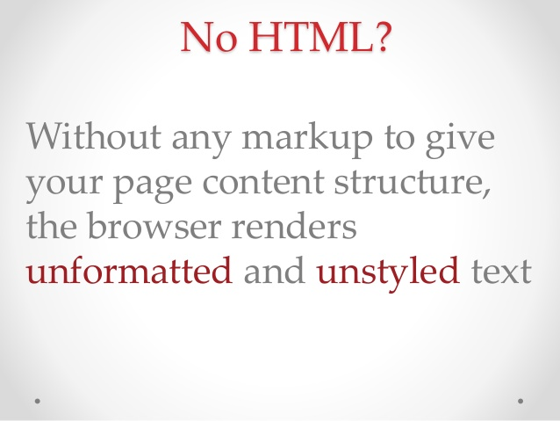

Slide 9


Slide 10


Slide 11


Slide 12


Slide 13
BACK END

Slide 14


Slide 15
DATABASE

Slide 16


Slide 17
ARCHITECURE DIAGRAM

Slide 18
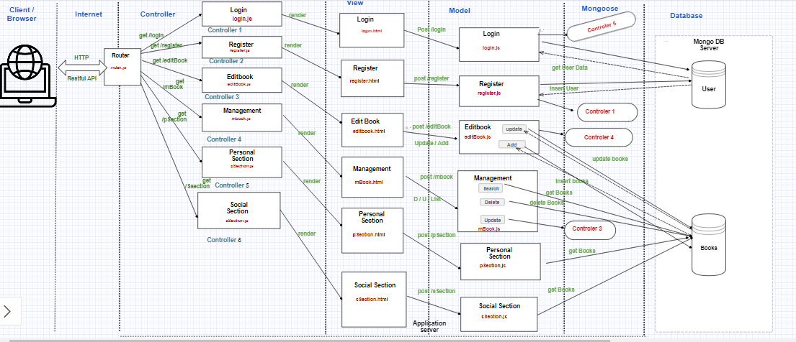

Slide 19
LOGIN PAGE
Login Page has Two Main Functionalities :
1) Login
2) Register

Slide 20
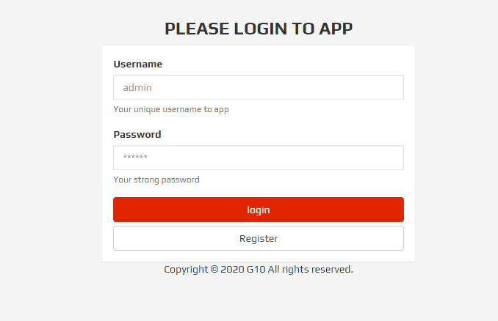
LOGIN PAGE

Slide 21
PERSONAL SECTION
Personal Section :
1) This section holds the list of books available in personal section
2) In addition to that it has customized search where we can able to search the books based on topics.

Slide 22
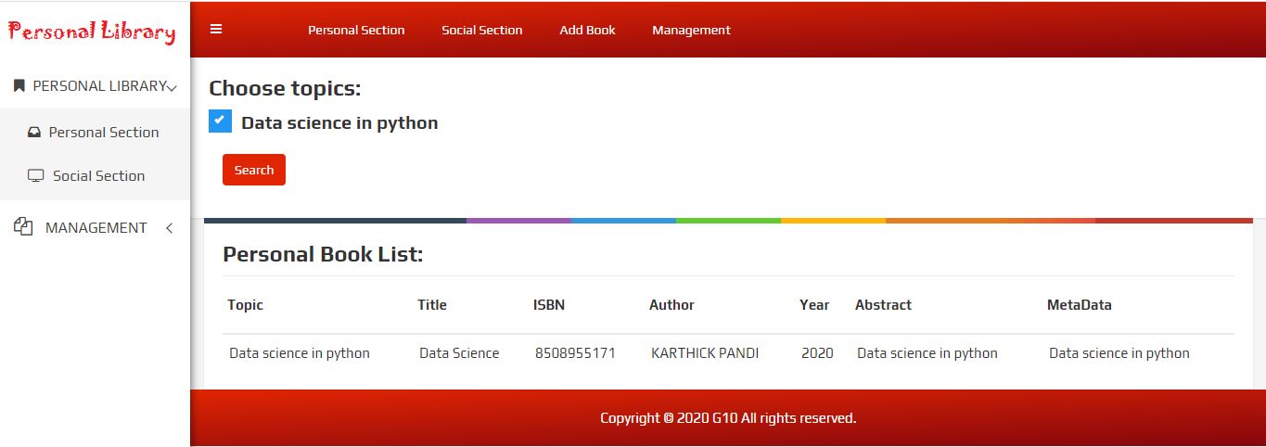
PERSONAL SECTION

Slide 23
SOCIAL SECTION
Social Section :
1) This section holds the list of books available in social section
2) In addition to that it has customized search where we can able to search the books based on topics.

Slide 24
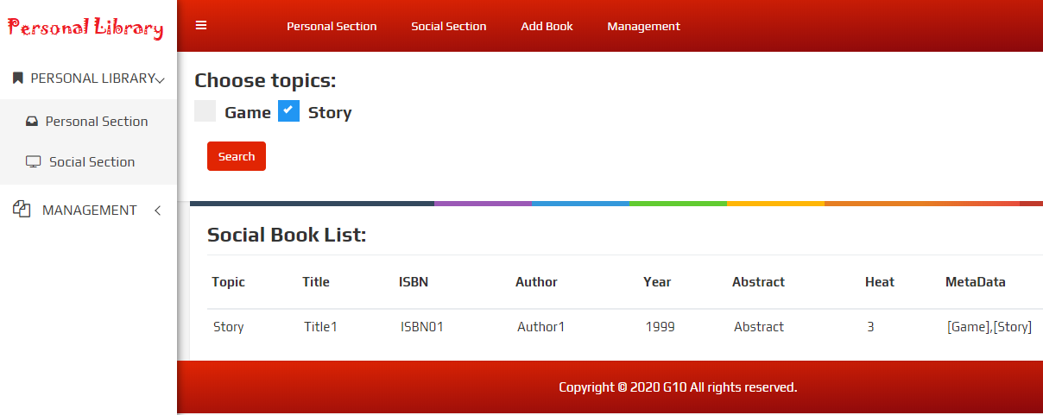
SOCIAL SECTION

Slide 25
ADD BOOK
Add Book :
1) Here we can add books to this library .The fields which required to add the books includes:
Title
Author
Public Year
ISBN
Abstract
Metadata

Slide 26
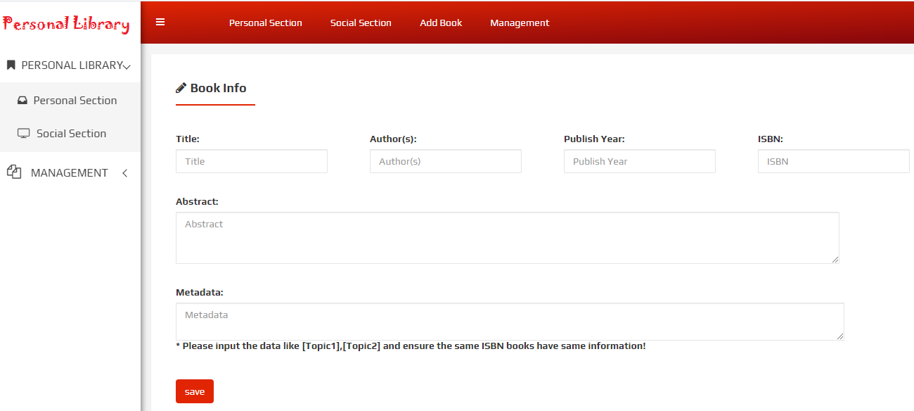
ADD BOOK

Slide 27
BOOK MANAGEMENT
Book Management :
1) Customized search based on Title,
Author Name, Published Year and ISBN

Slide 28
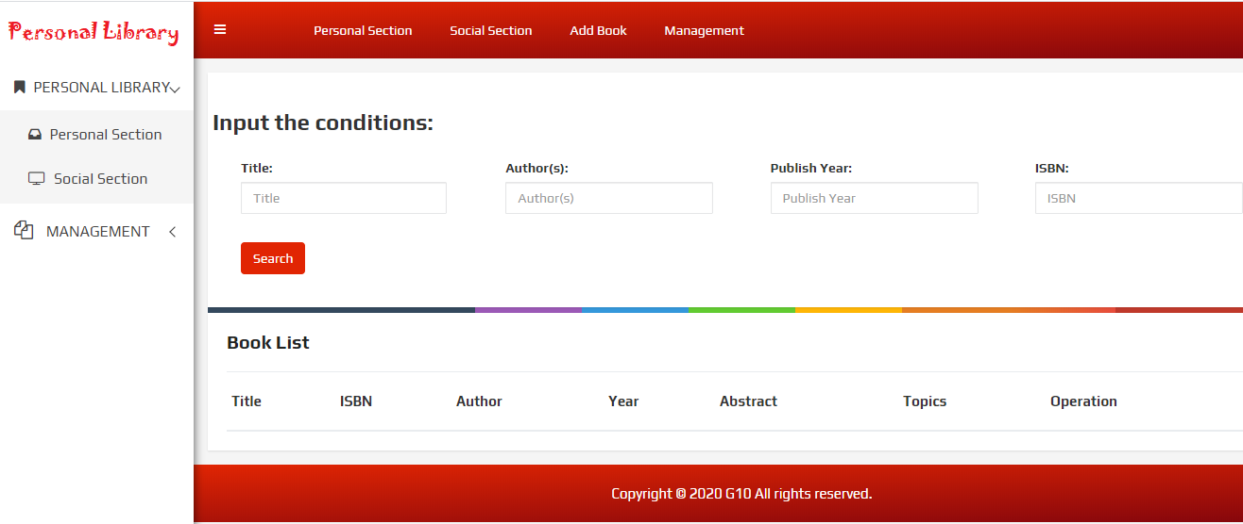
BOOK MANAGEMENT

Slide 29


